Slide 1
Stress in the workplace
By Henna and Harkamalpreet

Slide 2
stressors in the workplace
Environment; heating, lighting, arrangement of workplace etc.
Home-work interface; balancing the demands of home (children, family etc) and work – concept of ‘work life balance.
Control in the workplace – how much control a worker has in their job and what they do.
Workload – how much or little work is placed on the individual.
Interpersonal factors – how well you get on or work with other employees, boss etc.

Slide 3
Studies
Marmot et al.
The method he used was asking 7372 civil servants in London to answer a questionnaire.
He found no link between high workload and stress related illnesses. He found that people working in higher grades of civil service had developed fewer cardiovascular problems, and people working in lower grades had more problems. This is because the people working in the higher grades experienced higher job control and social support, whereas the lower grade people had a lower sense of job control and poorer social support.

Slide 4
Evaluation points
It was a self report questionnaire
Doesn't measure all factors, e.g. Vulnerability to disease.
The sample – easy to generalise(big sample), however not generalisable to other jobs.
Ethical, as long as there is a debriefing process and consent is given.

Slide 5
Other useful research studies
Johannson et al (1978) – higher level of stress hormones and stress relate illness in a group of highly skilled sawmill employees whose work was machine paced and therefore they had no control over it.
Fox et al (1993) – found a combination of low control and high demands was related to high blood pressure in nurses.
Pomaki et al (2007) – Studied 226 hospital doctors and showed that role conflict (work life balance) was directly associated with emotional exhaustion and depression.

Slide 6
Fill in the gap worksheet.

Slide 7
Answers to worksheet

Slide 8
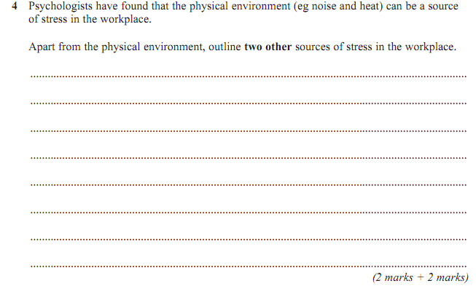
Exam questions
Answer:
There are many features in the workplace that can cause stress:
• Lack of control – where the individual feels they are unable to determine how much work they do, for how long, etc.
• Work overload/under load – too much or too little work can lead to stress.

Slide 9
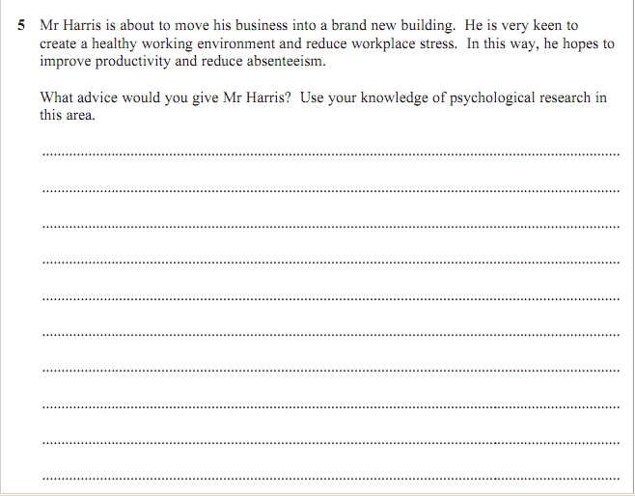
Answer:
Factors: Noise and temperature
Research has shown that certain types of noise affect memory and can lead to frustration.
Other research has shown that as temperature increases, so does aggression, and this can lead to stress. Other factors such as workload, lack of control, relationships with colleagues are also relevant. For example, several studies have shown that lack of control at work can lead to stress.
Research by Marmot: suggest that those with high control over their workload, were less stressed.

