Slide 1
Stress and personality types
By Vinay, Anjali and Fowsiya

Slide 2
Definition
Type A personality: A type of personality which is characterized by constant time pressure, competitiveness in work and social situations and anger.
Hardy personality: provides defences against the negative effects of stress. This can be seen by having control over stressful situations and a mindset to meet challenges.

Slide 3
Research on type A personality
Friedman & Rosenman
Carried out a group study with approximately 3000 men, aged 39-59, living in California
1. They were examined for signs of CHD (to exclude any participants who were already ill)
2. The participants sorted into personality types using structured interview
The interview asked questions on how they respond to everyday pressures
The interview also done in a provocative manner to bring out Type A behaviour
3. They were assessed 8.5 years later

Slide 4
Findings
· Twice as many Type A participants had died from cardiovascular problems
· 12% of Type A participants experienced a heart attack (compared to the 6% of Type Bs)
· Type As had higher blood pressure & higher cholesterol, more likely to smoke & have families with a history of CHD

Slide 5
Evaluation
Ragland & Brand’s follow up study shows that approximately 15% of the men had died from CHD. The study found little evidence between Type A behaviour & mortality – this challenges the conclusion that Type A behaviour is linked directly to CHD mortality

Slide 6
Continuing with evaluation
Myrtek’s meta-analysis of 35 studies only found a link between one of the components of the Type A personality – this was hostility. Other than that, there wasn’t any evidence between Type A personality & CHD

Slide 7
Type A and Type B behaviours
Type A | Type B
Competitive | Relaxed
Time urgent | One thing at a time
Hostile and aggressive | Express feelings
Rapid movement | Slower speech
Very intense | Slower movements
More likely to get CHD | Less likely to get CHD

Slide 8
Hardiness training
The aim of hardiness training is to increase self-confidence and sense of control so that individuals can more successfully navigate change in their lives.

Slide 9
Research on increased hardiness
Maddi et al (1998) got 54 managers who went on a hardiness training programme to report back on their progress.
They recorded an increase in hardiness and job satisfaction and a decrease in strain and illness.

Slide 10
Teaching hardiness training
Step 1: Focusing on stressor and learns about its symptoms
Step 2: Reliving stress encounters: Participant taught how to cope with the stressor
Step 3: Self-improvement: Participant learns how to cope and learns new techniques on how to cope.

Slide 11
Evaluating hardiness training
Strengths:
There is evidence from previous research by Maddi, where an increase in hardiness was recorded.
Weaknesses:
The procedures may be lengthy and require commitment of time and effort.
Cannot generalise because study only based on white middle-class businessmen.

Slide 12
Exam practice
Please take a few minutes break before attempting these questions. You must use a black ball-point pen and have a calculator ready.
Please look at the answers when you have tried your best and have no clue whatsoever.

Slide 13
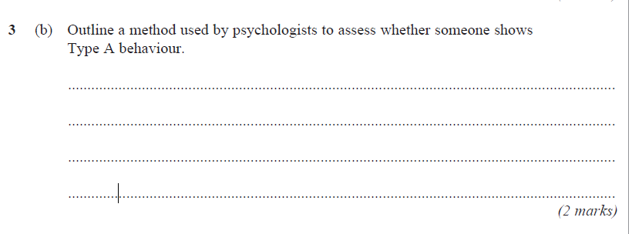
Numero uno: January 2009

Slide 14
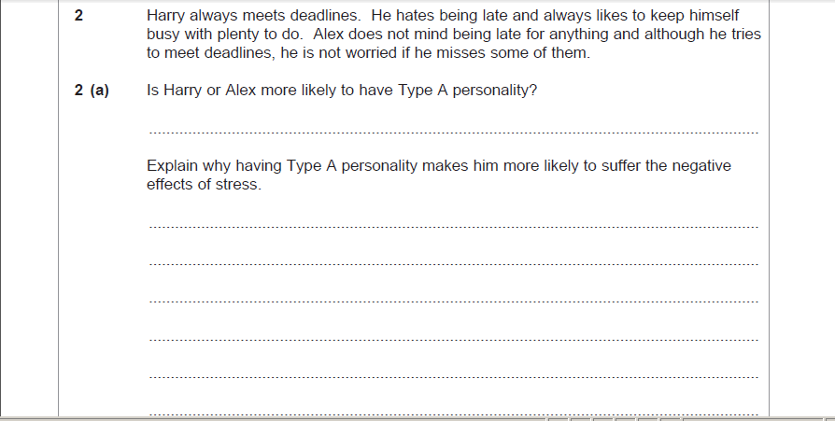
Numero dos: June 2010

