Slide 1
Type A, Type B and Hardiness Revision

Slide 2
There are important differences in the way that people react to stress as there are differences in the way they may react to other influences in their lives.
Personality can be thought of as a set of characteristics, attitudes ad general temperament that remain relatively stable
Research has established that some personality characteristics make us more vulnerable to the negative effects of stress while others make us more resistant.

Slide 3
What type A consists of ?
Type A behaviour is when the person is...
Time pressured- this is when they feel that they always have something to do
Competitive- they always have to win no matter what
Hostility- they are easily irritated
These people are more likely to have
coronary heart disease.

Slide 4
What Type B Consists Of ?
Type B behaviour consists of people who are
Patient
Relaxed
Easy going
This makes them less
vulnerable to getting
illnesses.

Slide 5
Friedman & Rosenman (1974)
They wondered why some men got heart conditions due to chronic stress while others didn´t. 3000 men were followed for a period of 8 years. A structured interview and a self-report measure was used to divide them into Type A personalities and Type B personalities. Then Freidman & Rosenman monitored the menś blood clotting ability and their serum cholesterol levels. They concluded that Type A personalities were much more likely to suffer the negative effects of chronic stress than Type B personalities. This is especially interesting to psychologists because it shows how personality factors affect health.

Slide 6
Model Answer:
Psychologists use interviews and questionnaires to measure type A personality.

Slide 7
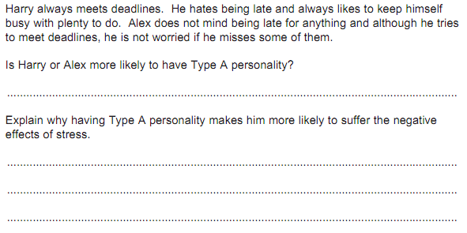
Model answer:
Harry
Model Answer:
The behaviour of such personality makes them more prone to stress related illnesses such as CHD or raised blood pressure. As a result they are more likely to have the stress hormones present, which over time leads to stress related illnesses.

Slide 8
The Hardy Personality
Although type A behaviour is claimed to be a risk for CHD, type A are resistant to hart disease.
Kobosa and Maddi (1977) suggested that people are just psychologically ‘Hardy’ than others.
Kobasa proposed that a hardy personality type encourages resilience.
The Hardy Personality includes a range of characteristics which provide defences against the negative effects of stress.

Slide 9
Focusing- The person is taught how to recognise the physiological signs of stress, this can be muscle tension and increased heart rate and they identify the source of the stress.
Reliving Stress Encounters- By reliving the stress encounters they can analyse the situation and their response to them. This gives them an insight into their coping strategies and how effective they may be.
Self Improvement- It is the new techniques they have learnt of dealing with stress so that they can move forward. The person is taught to see their stress as a challenge and take control of it rather than seeing their stress as a problem.

Slide 10
Myrtek
Meta analysis-35 studies on this topic and found an association between CHD and a component of Type A personality-hostility .
Other than this, there was no evidence of an association between Type A personality and CHD.

