Slide 1
Stress Management Techniques
Physiological (biofeedback and drugs)

Slide 2
The physiological approach to stress management:
This focuses on alleviating the emotions associated with the stressful situation, even if the situation itself cannot be removed. Drug therapies are the man physiological approach (e.g. Benzodiazepines & Beta-Blockers)

Slide 3
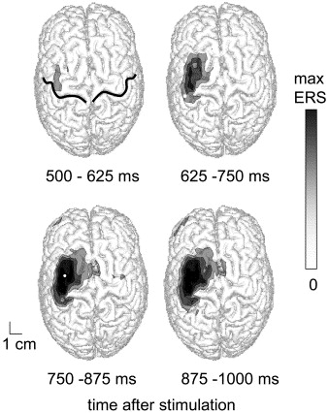
DRUGS!
DRUGS
Drugs

Slide 4
Beta-Blockers
They reduce the activity of adrenaline and noradrenalin. They bind to receptors on the cells of the heart (and other body parts that get stimulated at arousal) ultimately making the person feel calmer.

Slide 5
BZ’s
Benzodiazepines are the group of drugs most commonly used to treat anxiety and stress. They are effective in slowing down the central nervous system.
Gamma-amino butyric acid (GABA) is a neurotransmitter that is the body’s natural form of anxiety relief.
GABA when released reacts with the GABA receptors. When GABA locks into the neuron receptors, a channel opens which increases the flow of chloride ions into the neuron.
These ions make it harder for the neuron to be stimulated by other neurotransmitters, therefore slowing down its activity and making the person feel more relaxed.
BZs improve GABA action by binding to special sites on the GABA receptor and boosting the actions of GABA, this makes it even more resistant to excitation.

Slide 6
☺ Evaluation of Drugs!
-Fast (only have to remember to take the pills)
-Cheap
-BZ’s significantly more effective then placebo (Kahn et al.)
-(Hildalgo et al.) meta analysis on social anxiety- BZ’s more effective than antidepressants.
- Beta Blockers : very useful for sports such as darts and musicians as there occupation requires being calm for a good performance.

Slide 7
☹ Evaluation of drugs!
Addiction (patent can grow a dependency on the drug)
Side effects : May involve negative side effects such as increased aggression and impairing of memory (especially long term memory).
Treats the symptoms rather than the stressor itself (indirect).

Slide 8
Biofeedback
The biofeedback technique involves recording the bodily response created by the stressor such as heart rate, tension in muscles (such as the neck), & blood pressure.
This is usually recorded through monitors and machines activated by the electrodes on the skin of the patient.

Slide 9
The aim :
People are encouraged to try various things to try and improve the physiological readings. These strategies can involve muscle relaxation, meditation or even altering their posture.
The general aim is to find the right strategies to reduce, for instance, blood pressure consistently, and the transfer the strategy to from the lab to the ‘real world’.

Slide 10
Evaluation of biofeedback:
☺ - Effectiveness: can be very effective and successful for individuals, especially children (Attansio et al.) who enjoy the technological aspects in controlling there responses (e.g. migraines)
☹ - Role of relaxation: often found to be no more effective then muscle relaxation without the biofeedback (Masters et al).
☹ - Expense: Expensive equipment needed.

